Slide 1
Financing Adaptation to a Changing Ocean
Brief Summary of the Status of Public Finance Available
Notes:
We were asked to look at the status of public financing available and committed for oceans and climate change, and principally for adaptation. So we’ve focused on the types of adaptation costs already arising and those projected to arise, and taken a quick scan of current public financing mechanisms and amounts available.

Slide 2
Adaptation on Coasts, Islands, Ocean
2 Types of Costs
1. Costs to Vulnerable Coastal Populations – notably from sea level rise and storm surge
By 2030 at least 900 million people could be living in vulnerable, low-lying (< 10 m) coastal zones – mostly in Asia.
Source: Neumann et al (2015)
Notes:
The first type of costs we’re talking about is of course the significant costs to coastal populations, particularly in island nations, from sea level rise and increased storm surge. These costs are projected to grow as the vulnerable coastal population grows – by some estimates to 900 million by 2030.

Slide 3
Adaptation on Coasts, Islands, Ocean
2. Costs from changes to Ocean ecosystems & the services they provide
Almost 2/3rds of the total territory of 54 of the world’s low and lower-middle income coastal/island countries is ocean & depend on achieving SDG 14
Source: GPO Blue Ribbon Panel, 2013
Low income (GNI/cap < $1,035)
Lower-Middle Income (GNI/cap $1,036 - $4,085)
Upper-Middle Income (GNI/cap $4,086 - $12,615)
High Income (GNI/cap > $12,616)
Countries
incl ocean area
Notes:
There is also a second type of ocean adaptation cost that perhaps we think less about – the costs of adapting to changes in the ocean the services its ecosystems provide. Many of the world’s lower income countries depend heavily on the ocean’s resources for food, jobs and economic growth. These services are already under threat from overfishing, loss of coastal habitats and pollution. Now climate change impacts come on top of these stressors.
Many studies and experts have suggested that in the face of acidification and sea surface temperature increases for example, the best adaptation will be to reduce the other human-related stressors on ocean systems. Essentially this means achieving SDG 14 for conservation and sustainable use of the oceans. So we would suggest that we need to be thinking about the costs of meeting SDG 14 when we are thinking about the costs of ocean adaptation, because the ecosystem services that the ocean provides are so critical for so many coastal and island states.

Slide 4
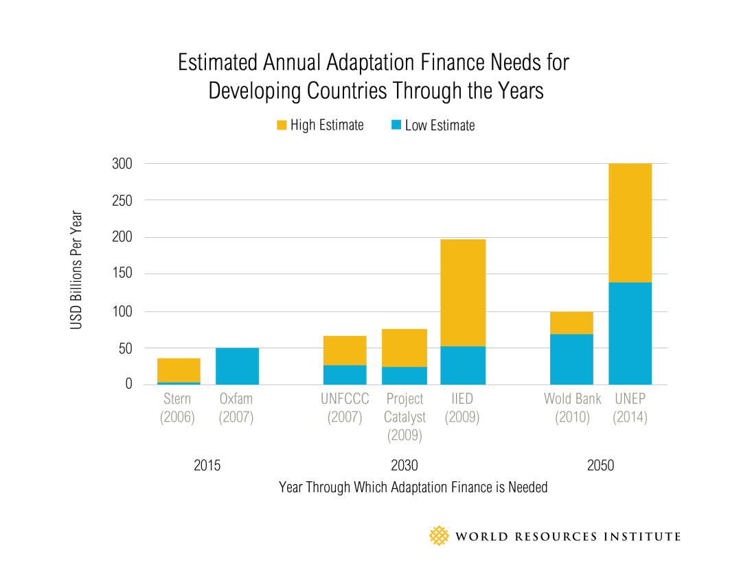
Total Ocean Adaptation Costs
The first type of costs – and only coastal protection costs – alone have been projected to US$12 to 71 billion per year by 2100 (UNEP, 2014).
Notes:
Estimates exist mainly for the first type of cost that I mentioned – and largely for coastal protection/grey infrastructure – on the order of $12 to $71 billion/year by 2100.
At the same time, the global costs of adaptation have been estimated by a number of organizations, most recently by the IPCC at some $70 to 100 billion annually by 2050.
UNEP found this estimate to be low, suggesting estimates on the order of US$300 billion for developing countries annually by 2050.

Slide 5
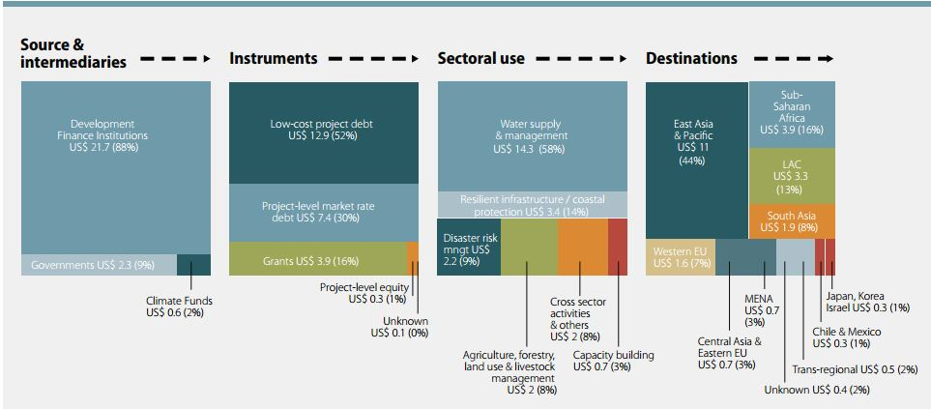
Status of Financing Available
Public finance for adaptation activities was US$23 - $26 billion in 2012-2013, a small % of which was invested towards coastal adaptation (UNEP, 2014)
Source: UNEP (2014)
Notes:
According to UNEP, the global amount of public finance committed to activities with explicit adaptation objectives ranged between US$23 billion and $26 billion in 2012 – 2013, of which 90% was invested in developing countries and a small percentage was invested towards coastal adaptation.
In terms of public financing mechanisms, we estimate roughly $10 billion is currently available for ocean/coastal adaptation – assuming that half of the funds currently committed in the Green Climate Fund are available for adaptation.

Slide 6
Some Preliminary Recommendations
Dedicated window in global financing mechanisms for ocean/coastal adaptation – i.e. earmarking funds?
Earmark 10% of investment in coastal ‘grey’ infrastructure for habitat restoration and/or protection
Develop voluntary mechanisms, such as ‘ocean toll’ on shipping proposed by Ocean Recovery Alliance
Develop a financial tracking mechanism for public flows to fund coastal/ocean adaptation.
Notes:
Currently there is no global financing mechanism dedicated to ocean adaptation – such as a coastal adaptation fund. While the prospects for a new financing mechanism may not be realistic, states may wish to consider establishing dedicated windows for coastal/ocean adaptation within current global mechanisms – essentially earmarking funds.
Additionally, a proposal has been made that a portion of the funds that will be invested from a range of sources in coastal grey infrastructure over the coming years, be dedicated to coastal green infrastructure – habitat protection and restoration – for the reasons mentioned earlier.
The Ocean Recovery Alliance has proposed a voluntary mechanism for the private sector, whereby shipping cargo might pay a small ‘ocean toll’ collected into a global fund for investments in ocean health and adaptation.
Regardless of the mechanisms, there is currently little information on global financing flows for ocean adaptation, and so it has been proposed to set up a small tracking mechanism to start to monitor actual flows, perhaps drawing from National Adaptation Programs of Action and similar instruments.

